Slide 1
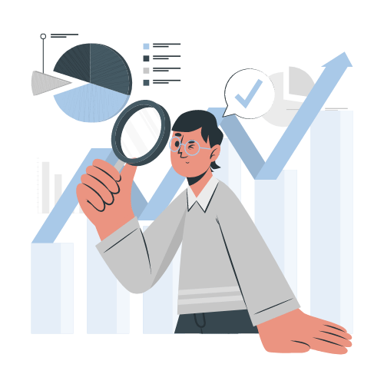
Employee
PROMOTION
PREDICTION
Revolutionize your promotion process

Slide 2
table of contents
01
02
03
Project OVERVIEW
Implementation
Test cases
04
05
06
Related work
conclusion
Future work

Slide 3

PROJECT
01
OVERVIEW

Slide 4
190,000
employees across 33 countries found that career advancement opportunities, including promotions, were among the top factors that employees consider when evaluating potential companies.

Slide 5

PROBLEM VS. SOLUTION
PROBLEM
SOLUTION
58% of employees are dissatisfied with their company's promotion process
19% of employees believe that promotions in their organization are based on merit.
.
Our dashboard uses data analysis for fair and objective employee promotions.
Our dashboard provides training recommendations for underperforming employees.
Our dashboard provides insights to identify trends in employee promotion rates over time

Slide 6
—Peter F. Drucker
ʻ
ʻ
“What gets measured gets improved.”

Slide 7

02
IMPLEMENTATION

Slide 8
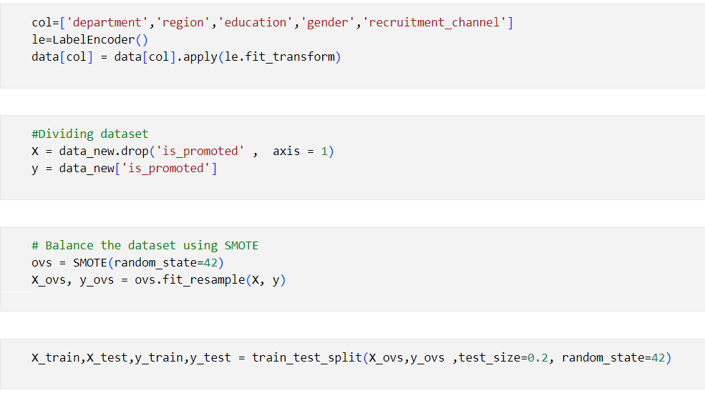
Model building

Slide 9
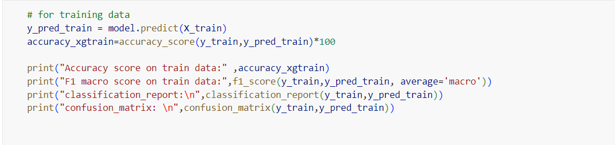
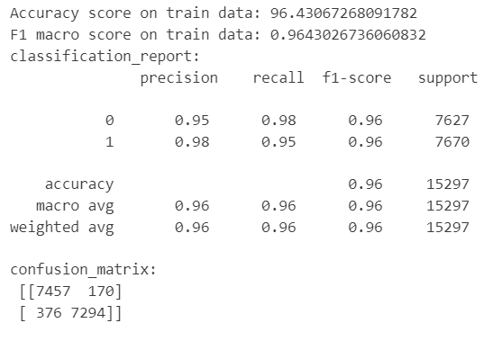
XGBOOST ALGORITHM​

Slide 10
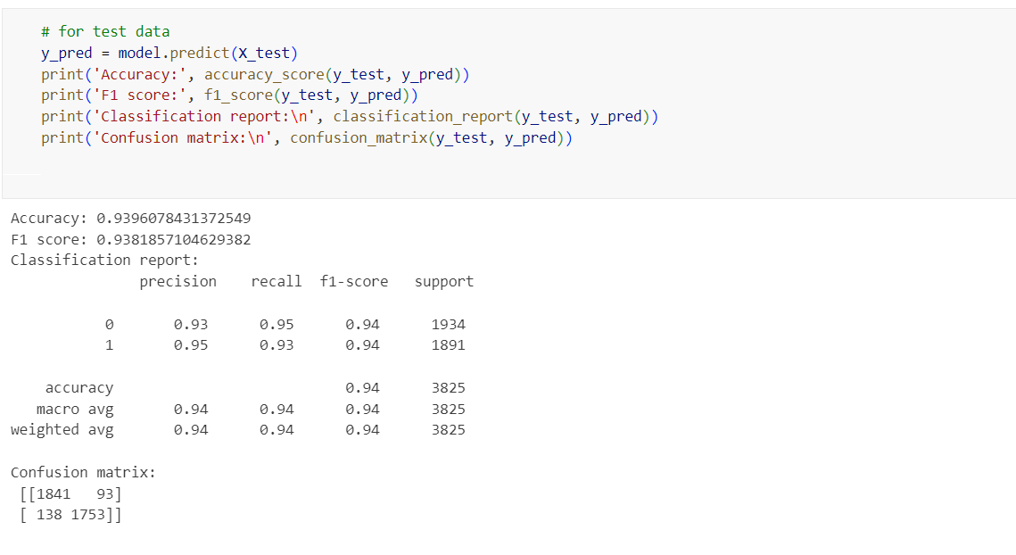
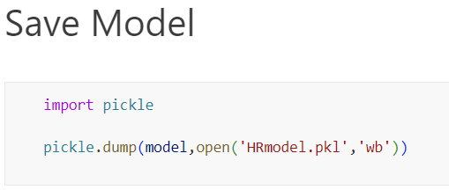
XGBOOST ALGORITHM​

Slide 11

03
TEST
cASES

Slide 12
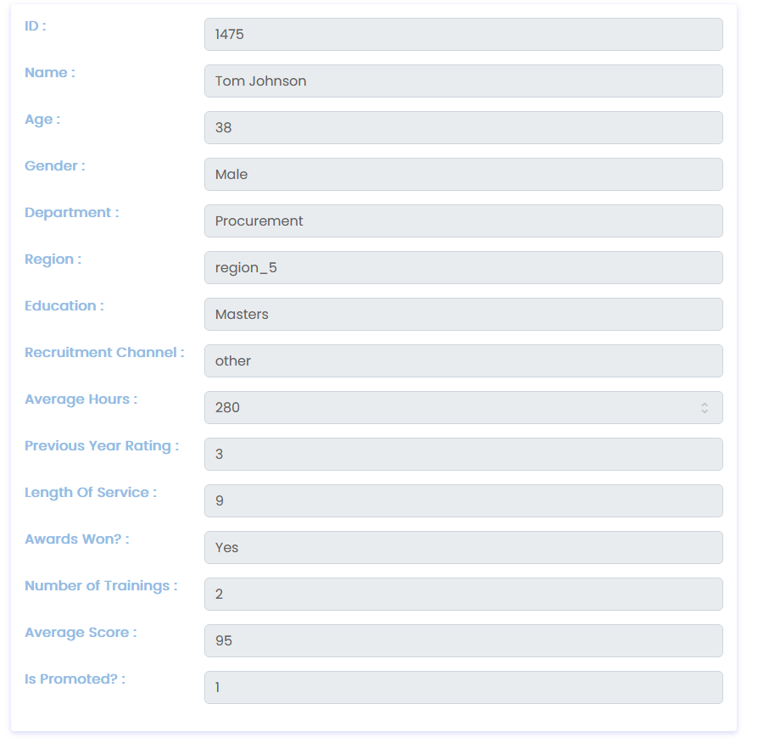
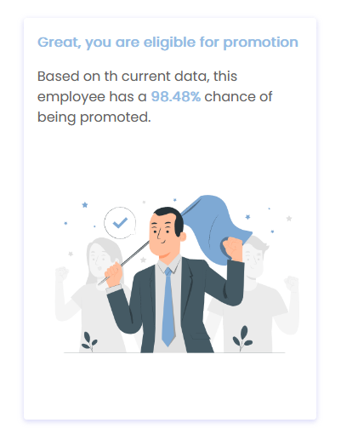

Slide 13
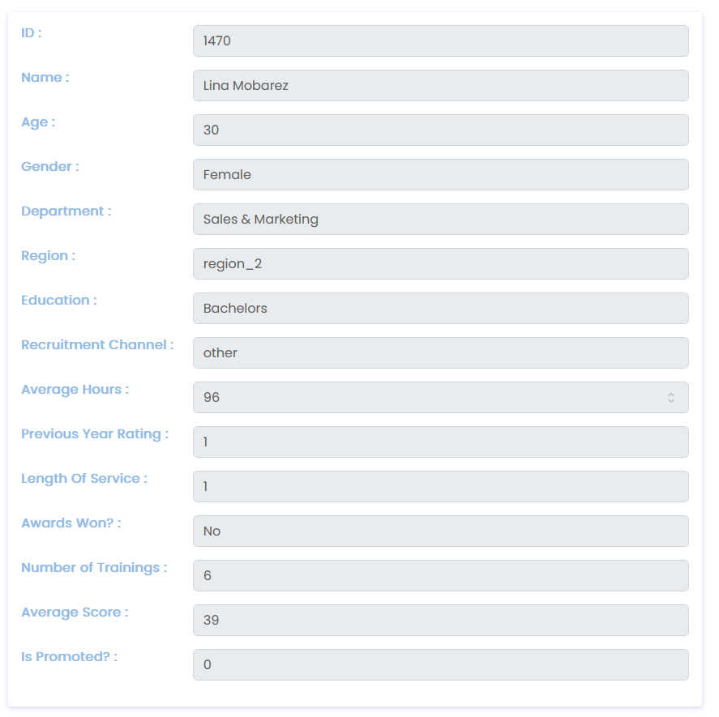
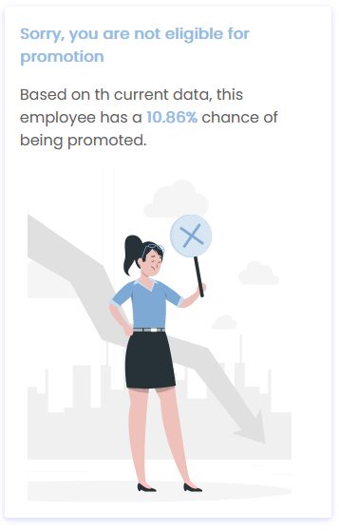
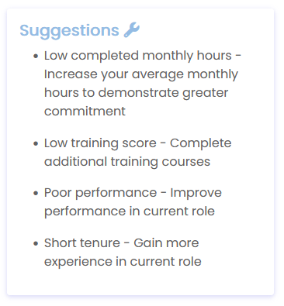

Slide 14

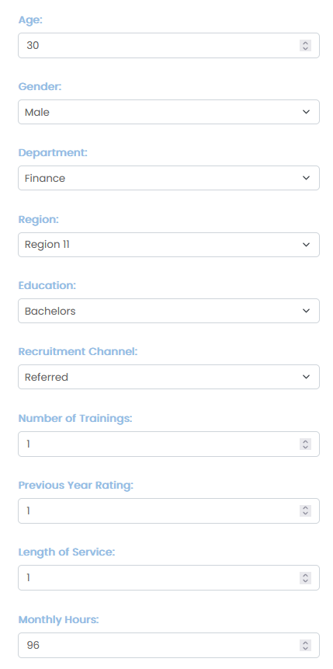
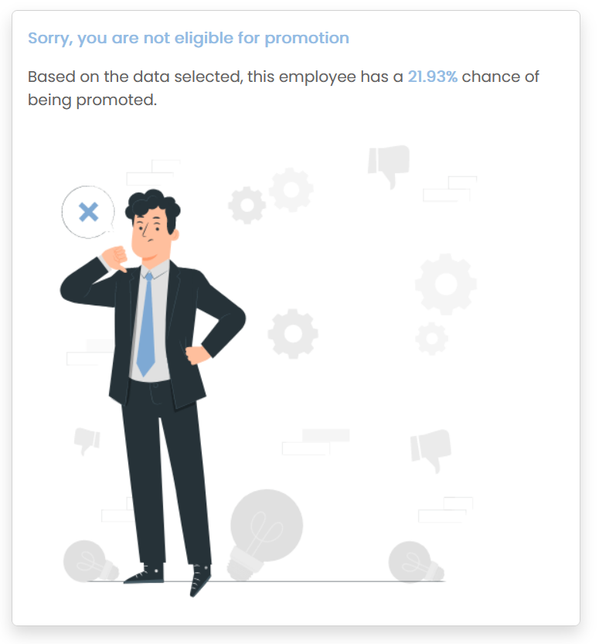
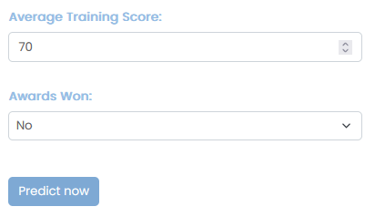

Slide 15
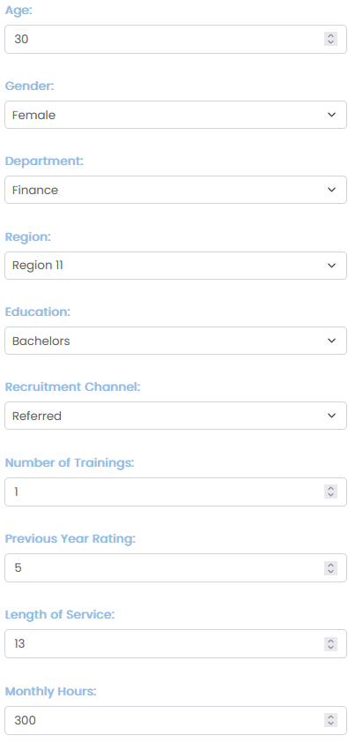
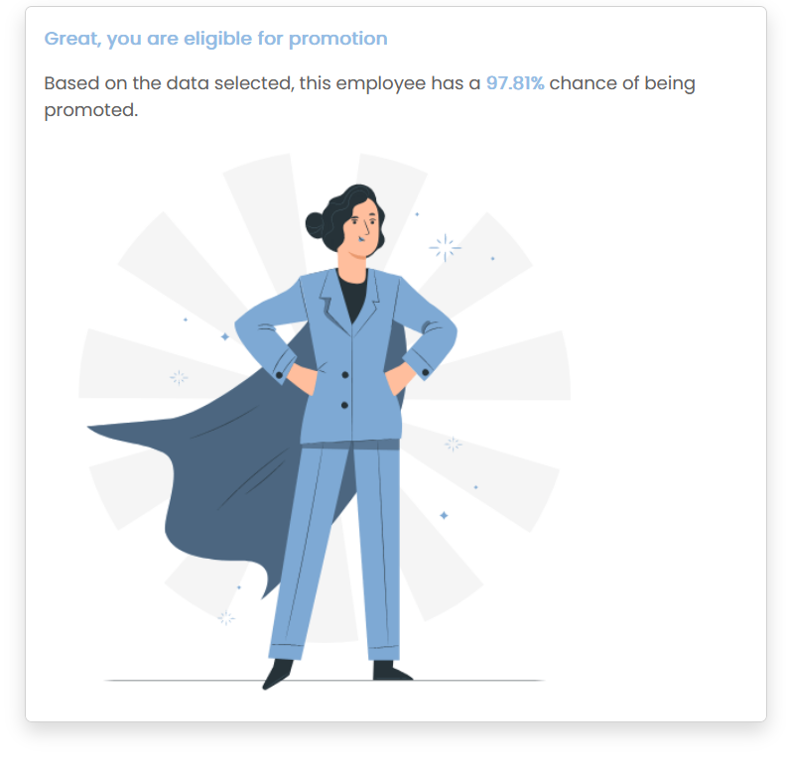
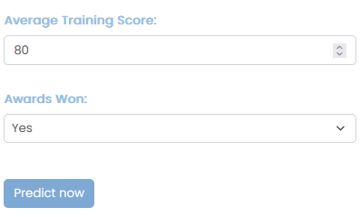

Slide 16
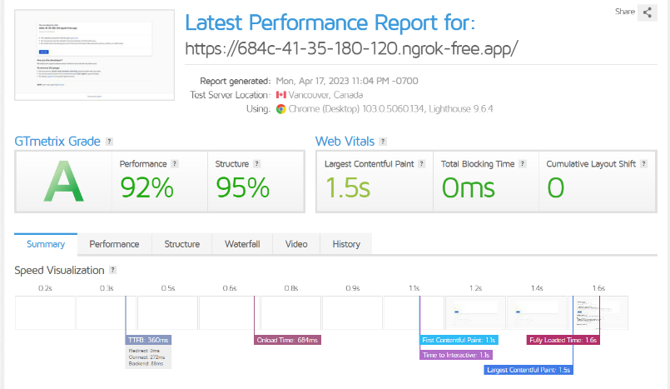

Slide 17

04
Related
WORK

Slide 18

Existing models
Prediction of Employee Promotion based on raing by Zhanuzakov M.B. and Balakaeva
Predictive Analytics on Employees Promotion by Huda Hannani
Three Algorithms used:
GB: 96%, RF: 95%, Keras: 98%
Three Algorithms used:
LG: 93.4%, KNN: 92.5%, DT: 89.5%

Slide 19
LOOKS CAN BE DECIEVING

Slide 20

LET'S TAKE A CLOSER LOOK
​ ​
Prediction of Employee Promotion based on raing by Zhanuzakov M.B. and Balakaeva​
DATASET USED
17400 ENTRIES, 8 FEATURES
​
Predictive Analytics on Employees Promotion by Huda Hannani
PRECISION
​

Slide 21

PROPOSED model
The proposed model is a better solution for predicting employee promotions due to its training on a larger dataset, more features achieving an accuracy of 96% and Precision, Recall and F1 scores over 90%.

Slide 22
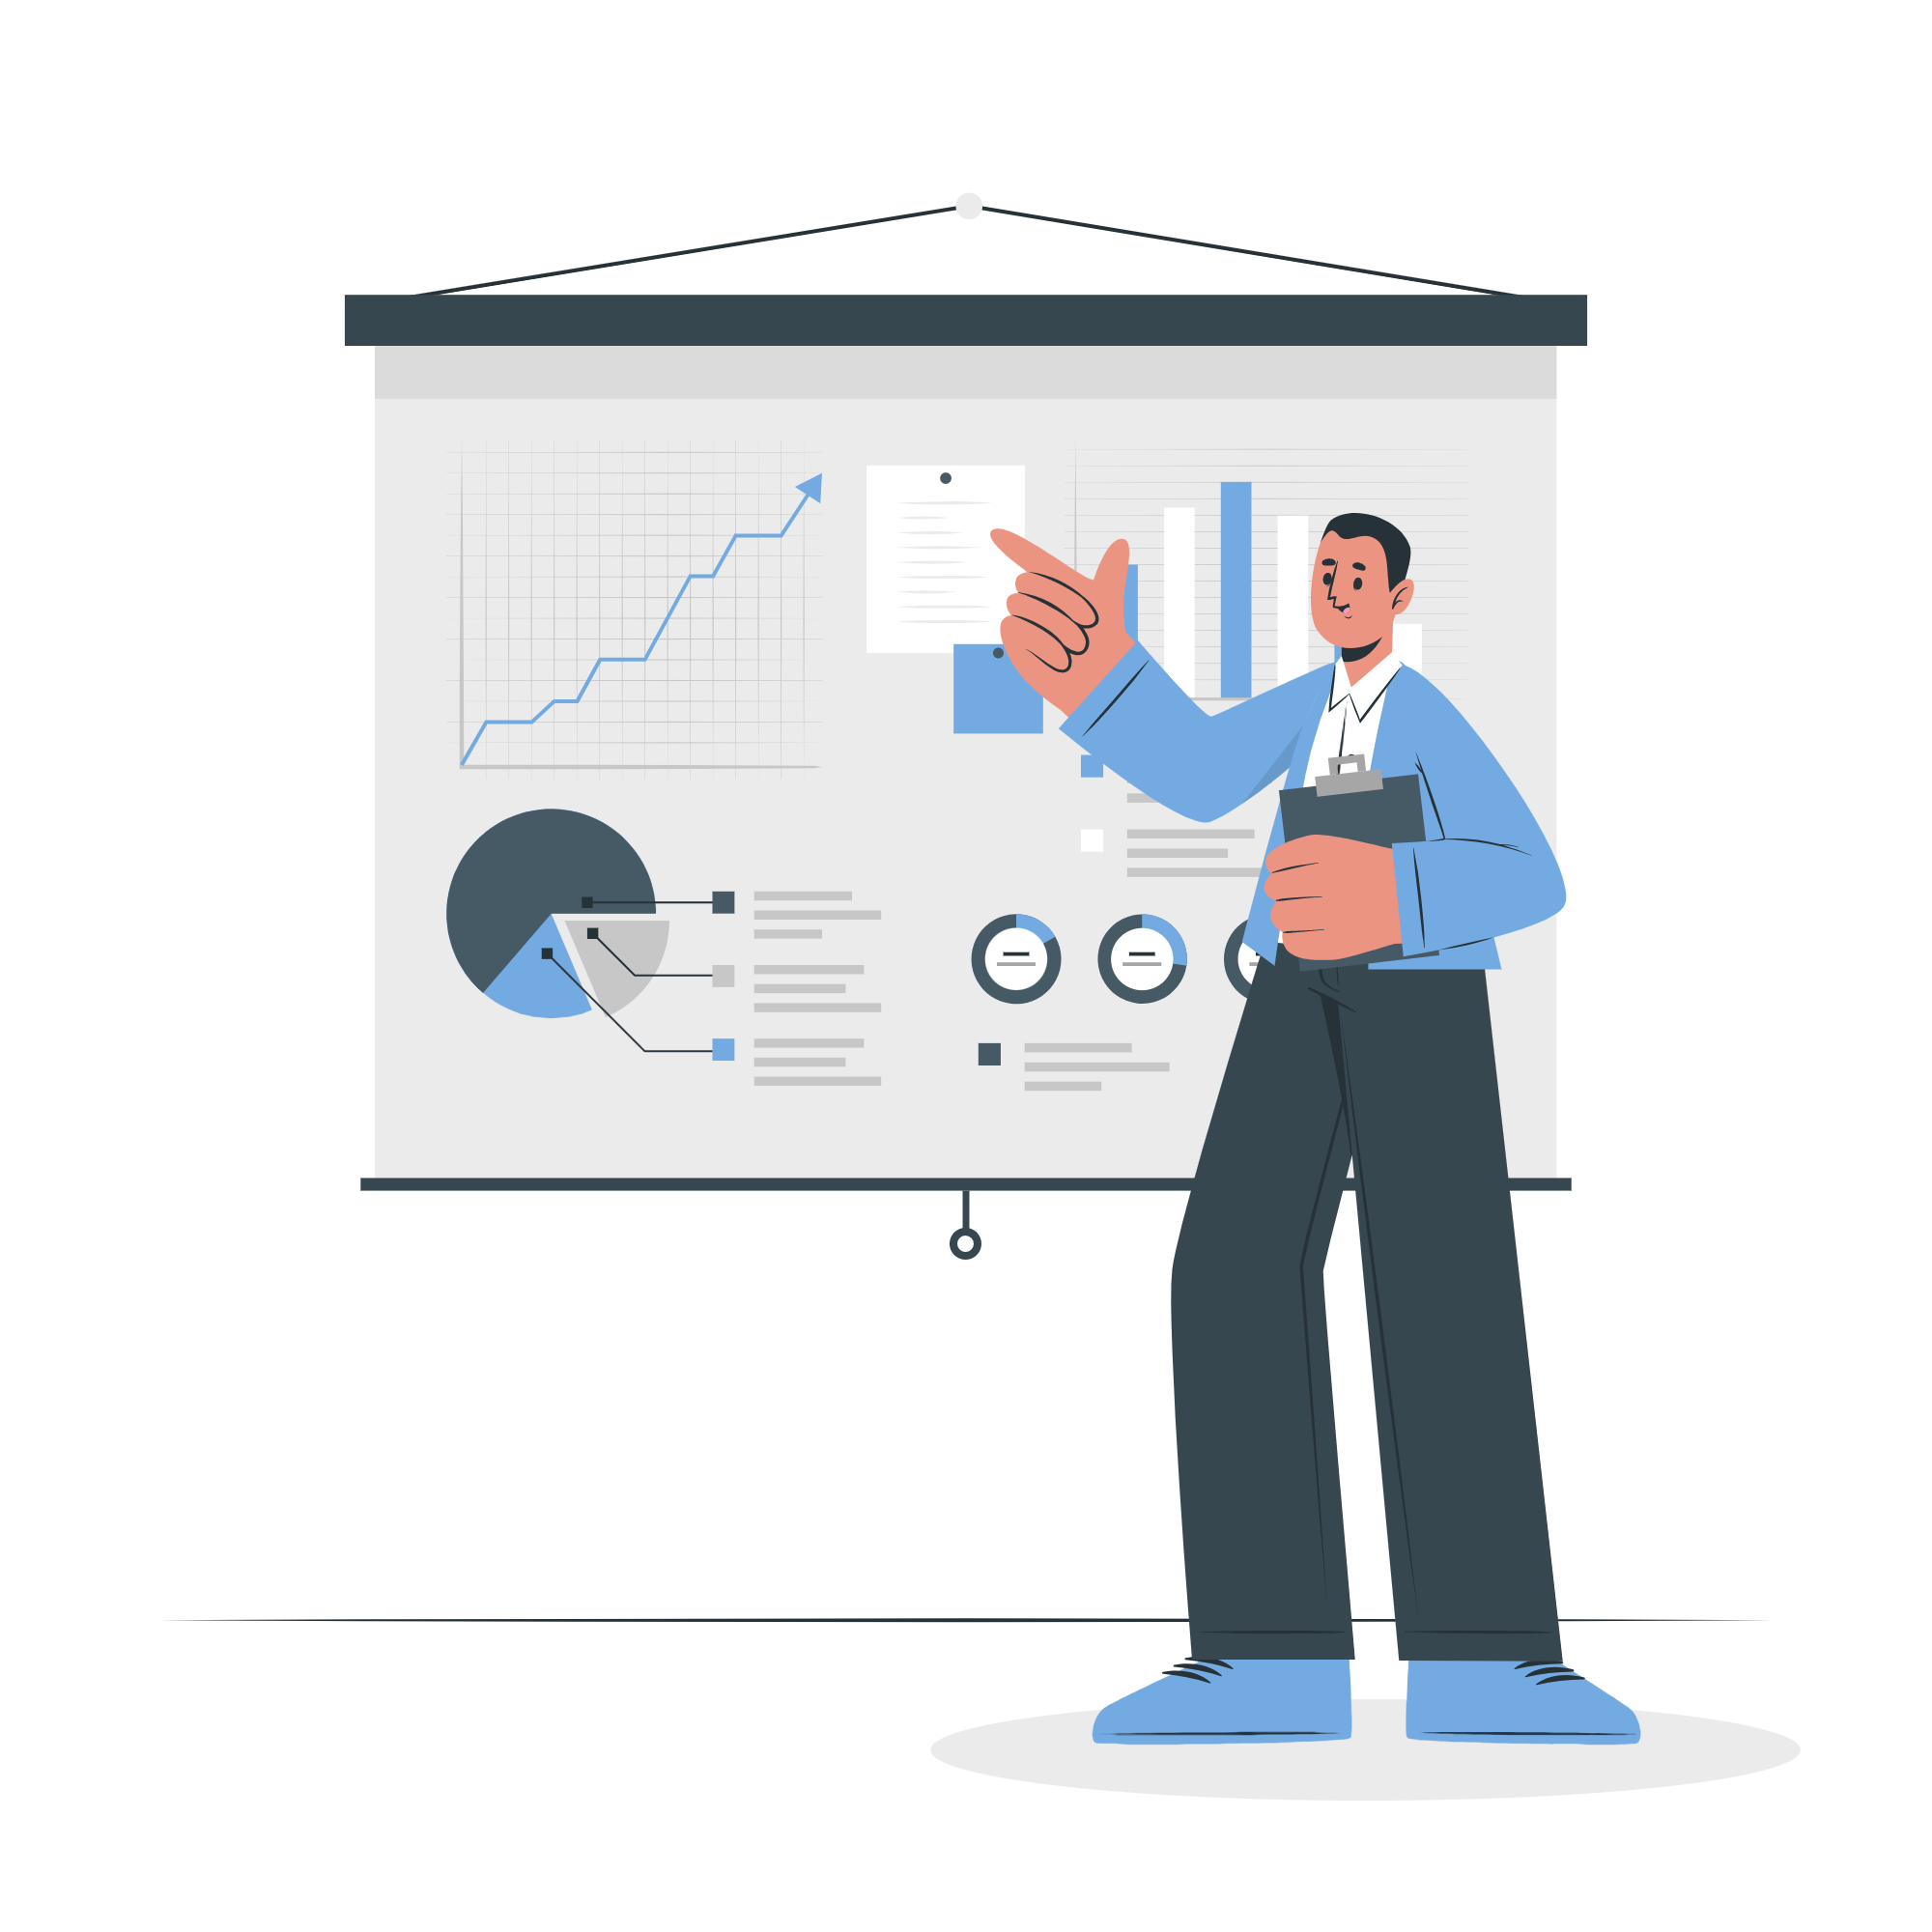
CONCLUSION
05

Slide 23

To sum up, the promotion prediction dashboard we've created using XGBoost algorithm is a powerful tool for HR and employees alike. By providing accurate predictions of employee promotions, it can help organizations make informed decisions and retain top talent.

Slide 24

FUTURE
06
WORK

Slide 25

Future work will focus on adding new features, such as employee access to the dashboard and improving the accuracy of the machine learning model. With continued development, this tool has the potential to transform the way companies make informed decisions about promotions and ensure employees can advance based on their true potential.

Slide 26

Thank you!
I'd love to hear your thoughts on the potential website of our promotion prediction dashboard
Lina Mohey El-Din Gomaa 1951710183
Final Year Project, Dec 2022 Supervisor: Dr/ Ibrahim Mohamed El Hasnony.

